Slide 1
Lecture 2
Individual Presentations, Lifelong Learning and Leadership

Slide 2
Individual presentation
Choose a technical topic in CS (not material from your earlier classes)
Email the topic and an agenda about the presentation content to me (mhekmatn@asu.edu ) a week ahead of your date of presentation
Use this title: “CSE-486 Presentation Topic”
10 minutes of speaking/presentation
2 minutes for questions
Think TED
Why is this of interest?
What did you learn?
What should the audience take away?

Slide 3
Presentation Tips
Make it interesting
Know your audience
Be enthusiastic/passionate
Aesthetic slides
Make it worthwhile
Do your research
Put effort into making slides (visual aids and graphics)
Ensure a learning outcome for the audience
Practice, practice, …

Slide 4
Rubrics
Delivery – 25%
Professional in appearance, attitude and speech
Natural, confident delivery; great use of volume, pace etc.
Very few fillers or hesitation
Good eye contact; aware of audience reaction
Did not read from notes or slides
Appeared well prepared and rehearsed in speech and gestures
Repeated questions before answering; answers were professional

Slide 5
Rubrics
Slides – 25%
Slides were easy to read, error free and well formatted
Extra effort was shown in creating slides
All content could be easily viewed from back of room
Content – 25%
References were discussed
Adequate research was shown
Content was appropriate for audience
Learning method and goals for presenter and audience were discussed
Timing – 25%
Length of presentation was 9-10 minutes without questions

Slide 6
Non-presenters
Attendance – Minimum of 7 sessions
Evaluation – You will be assessed on the presentations
Submit the assessment for minimum 4 sessions
The assessment form/questions will be available on the Blackboard after the presentation (I try to bring hard copies in class)
Presentations will be made available on Blackboard before the session
Submit by the next class

Slide 7
Lifelong Learning
“Anyone who stops learning is old, whether at twenty or eighty. Anyone who keeps learning stays young.”
– Henry Ford
“Intellectual growth should commence at birth and cease only at death.”
– Albert Einstein

Slide 8
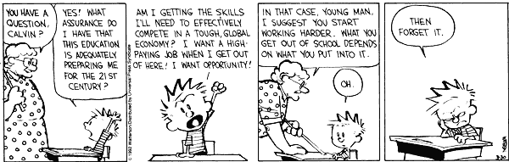
What is Lifelong Learning?
It is the ongoing voluntary and self-motivated pursuit of knowledge for professional and personal reasons.
-Wikipedia

Slide 9
Why Lifelong Learning
You will better adapt to an ever changing world
You will earn more
You will be interesting and charismatic
You will be a leader
You will be independent
You will be healthy
You will be more satisfied with life
You will earn a degree every year
-adapted from Brett & Kate McKay – How and why to become a Lifelong Learner

Slide 10
How to become a Lifelong Learner
Be disciplined
Encourage and sustain curiosity
Surround yourself with intellectual friends
Adapt learning to suit your style
Establish goals
Maintain blogs, vlogs and websites
Create learning groups
Teach and test yourself
30 second learning rule

Slide 11
Sources for Lifelong Learning
Coursera, edX, Udacity
Khan Academy
TED
iTunes U, YouTube EDU
Code Academy
Books, Books, Books, …
Build your own platform!

Slide 12
Lifelong Learning
“The real voyage of discovery consists not in seeking new lands, but in seeing with new eyes.”
– Marcel Proust
“I don’t think much of a man who is not wiser today than he was yesterday.”
– Abraham Lincoln
“I have never let my schooling interfere with my education.”
-Mark Twain

Slide 13
Leadership
“If your actions inspire others to dream more, learn more, do more and become more, you are a leader.”
– John Quincy Adams
“A genuine leader is not a searcher of consensus but a molder of consensus.”
– Martin Luther King, Jr.
“Leadership and learning are indispensable to each other.”
- John F Kennedy

Slide 14
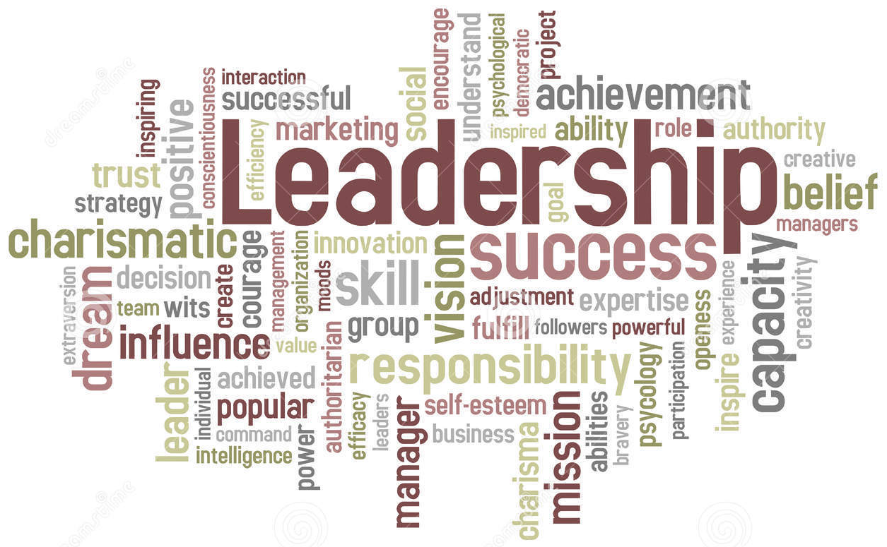
Leadership
-image from dreamstime.com

Slide 15
When can you be a leader
Lead the team meetings
Lead the work on release
Lead the work on report
Lead the work on presentation
Lead the work on video
“To command is to serve, nothing more and nothing less.”
– Andre Malraux

Slide 16
Leadership attributes for team project
Establishing a vision
Communicating the vision so others follow willingly
Building commitment within the team
Ability to negotiate and resolve conflicts

Slide 17
How to get a job at Google
Apart from the technical ability required for the job:
Learning ability – ability to process information on the fly, to pull together disparate bits if information. This is evaluated using structured behavioral interviews.
Leadership – Emergent leadership. When the team faces a problem, can you come forward and lead. And just as critically, do you step back and stop leading, do you let someone else.
Intellectual humility – Have a big ego and a small ego at the same time. Be a zealot about your point of view and yet be ready to let it go.
- How to get a job at Google – NY Times, Thomas L Friedman

